Slide 1
DataFrames
Create DataFrames

Slide 2
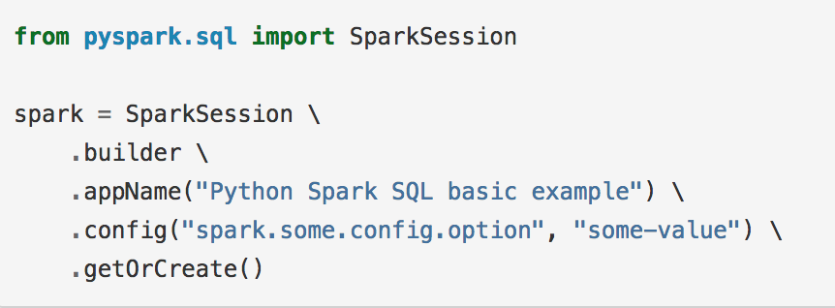
Create DataFrames
To work with DataFrames you must first create a SparkSession.
(notebook : SparkDataFrame/ CreateDataFrames.ipynb)

Slide 3
Creating DataFrames
There are two ways to create DataFrames
From an external file using either an inferred schema or one that you provide
From an exiting RDD

Slide 4
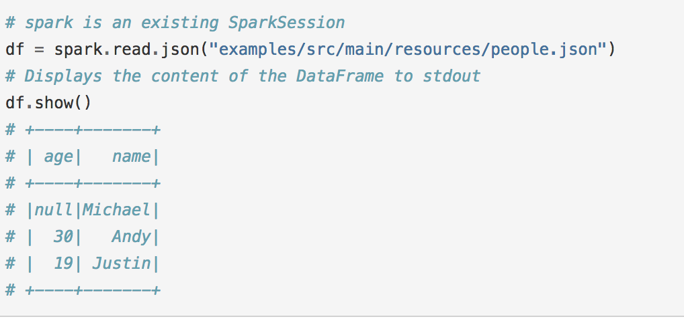
Create a DataFrame from an outside source with an inferred schema

Slide 5
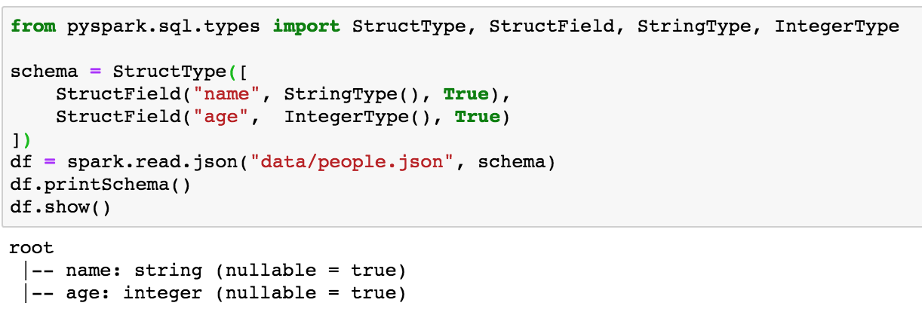
Define the schema, then read into a DF
.

Slide 6
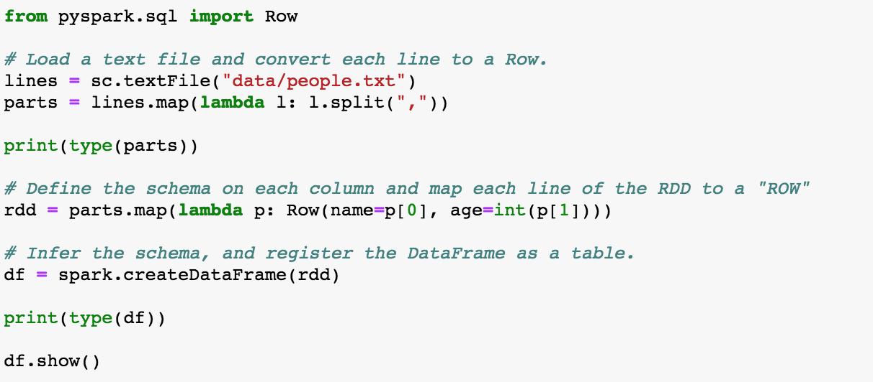
Read an RDD, then map to a "ROW" (df), apply a schema

Slide 7
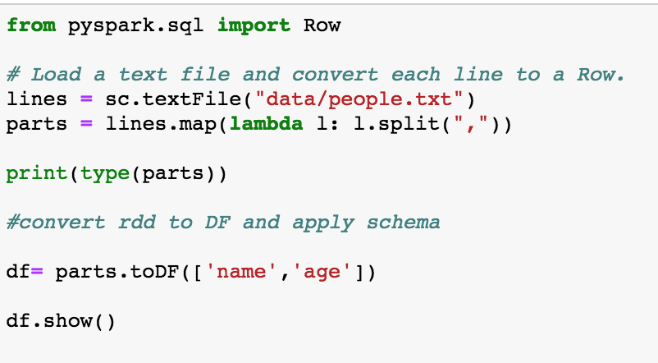
Read data into a RDD, convert to DF using toDF() and schema

